Slide 1
.NET/C# Training
Parthiban
30/10/2023
Notes:
This template can be used as a starter file for presenting training materials in a group setting.
Sections
Right-click on a slide to add sections. Sections can help to organize your slides or facilitate collaboration between multiple authors.
Notes
Use the Notes section for delivery notes or to provide additional details for the audience. View these notes in Presentation View during your presentation.
Keep in mind the font size (important for accessibility, visibility, videotaping, and online production)
Coordinated colors
Pay particular attention to the graphs, charts, and text boxes.
Consider that attendees will print in black and white or grayscale. Run a test print to make sure your colors work when printed in pure black and white and grayscale.
Graphics, tables, and graphs
Keep it simple: If possible, use consistent, non-distracting styles and colors.
Label all graphs and tables.

Slide 2
IF Statement
if (boolean-expression)
{
// statements executed if boolean-expression is true
}
else
{
}
if (true)
{
// statements executed if boolean-expression is true
}
else
{
}
Notes:
Give a brief overview of the presentation. Describe the major focus of the presentation and why it is important.
Introduce each of the major topics.
To provide a road map for the audience, you can repeat this Overview slide throughout the presentation, highlighting the particular topic you will discuss next.

Slide 3
UserName == "admin" && Password == "password@123"
true
true
&&
true
If(true){}
Else
{
}

Slide 4
IF Statement
if (condition)
{
// block of code to be executed if the condition is True
}
else
{
// block of code to be executed if the condition is False
}
int time = 20;
if (time < 18)
{
Console.WriteLine("Good day.");
}
else
{
Console.WriteLine("Good evening.");
}
// Outputs "Good evening."
Notes:
Give a brief overview of the presentation. Describe the major focus of the presentation and why it is important.
Introduce each of the major topics.
To provide a road map for the audience, you can repeat this Overview slide throughout the presentation, highlighting the particular topic you will discuss next.

Slide 5
using System;
namespace Conditional
{
class IfStatement
{
public static void Main(string[] args)
{
int number = 2;
if (number < 5)
{
Console.WriteLine("{0} is less than 5", number);
}
Console.WriteLine("This statement is always executed.");
}
}
}

Slide 6
if (boolean-expression)
{
// statements executed if boolean-expression is true
}
else
{
// statements executed if boolean-expression is false
}
if (number < 5)
{
number += 5;
}
else
{
number -= 5;
}

Slide 7
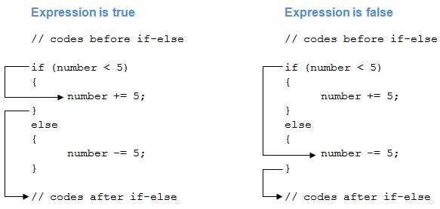
number = 4
number = 6

Slide 8
public static void Main(string[] args)
{
int number = 12;
if (number < 5)
{
Console.WriteLine("{0} is less than 5", number);
}
else
{
Console.WriteLine("{0} is greater than or equal to 5", number);
}
Console.WriteLine("This statement is always executed.");
}

Slide 9
if (boolean-expression-1)
{
// statements executed if boolean-expression-1 is true
}
else if (boolean-expression-2)
{
// statements executed if boolean-expression-2 is true
}
else if (boolean-expression-3)
{
// statements executed if boolean-expression-3 is true
}
.
.
.
else
{
// statements executed if all above expressions are false
}

Slide 10
if (condition1)
{
// block of code to be executed if condition1 is True
}
else if (condition2)
{
// block of code to be executed if the condition1 is false and condition2 is True
}
else
{
// block of code to be executed if the condition1 is false and condition2 is False
}

Slide 11
public static void Main(string[] args)
{
int number = 12;
if (number < 5)
{
Console.WriteLine("{0} is less than 5", number);
}
else if (number > 5)
{
Console.WriteLine("{0} is greater than 5", number);
}
else
{
Console.WriteLine("{0} is equal to 5");
}
}

Slide 12
public static void Main(string[] args)
{
int number = 12;
if (number < 5)
{
Console.WriteLine("{0} is less than 5", number);
}
else if (number > 5)
{
Console.WriteLine("{0} is greater than 5", number);
}
else
{
Console.WriteLine("{0} is equal to 5");
}
}

Slide 13
if (boolean-expression)
{
if (nested-expression-1)
{
// code to be executed
}
else
{
// code to be executed
}
}
else
{
if (nested-expression-2)
{
// code to be executed
}
else
{
// code to be executed
}
}

Slide 14
int time = 22;
if (time < 10)
{
Console.WriteLine("Good morning.");
}
else if (time < 20)
{
Console.WriteLine("Good day.");
}
else
{
Console.WriteLine("Good evening.");
}
// Outputs "Good evening."

Slide 15
C# Switch Statements
switch(expression)
{
case x:
// code block
break;
case y:
// code block
break;
default:
// code block
break;
}
Switch(<Expression>)
{
Case <Value> :
<stmts>
Break;
-----------------------
-------------------------
------------------------
Default :
<stmts>
Break;
}

Slide 16
Switch
int day = 4;
switch (day)
{
case 1:
Console.WriteLine("Monday");
break;
case 2:
Console.WriteLine("Tuesday");
break;
case 3:
Console.WriteLine("Wednesday");
break;
case 4:
Console.WriteLine("Thursday");
break;
case 5:
Console.WriteLine("Friday");
break;
case 6:
Console.WriteLine("Saturday");
break;
case 7:
Console.WriteLine("Sunday");
break;
}
// Outputs "Thursday" (day 4)

Slide 17
Switch
int day = 4;
switch (day)
{
case 6:
Console.WriteLine("Today is Saturday.");
break;
case 7:
Console.WriteLine("Today is Sunday.");
break;
default:
Console.WriteLine("Looking forward to the Weekend.");
break;
}
// Outputs "Looking forward to the Weekend."

Slide 18
char ch;
Console.WriteLine("Enter an alphabet");
ch = Convert.ToChar(Console.ReadLine());
switch(Char.ToLower(ch))
{
case 'a':
Console.WriteLine("Vowel");
break;
case 'e':
Console.WriteLine("Vowel");
break;
case 'i':
Console.WriteLine("Vowel");
break;
case 'o':
Console.WriteLine("Vowel");
break;
case 'u':
Console.WriteLine("Vowel");
break;
default:
Console.WriteLine("Not a vowel");
break;
}

Slide 19
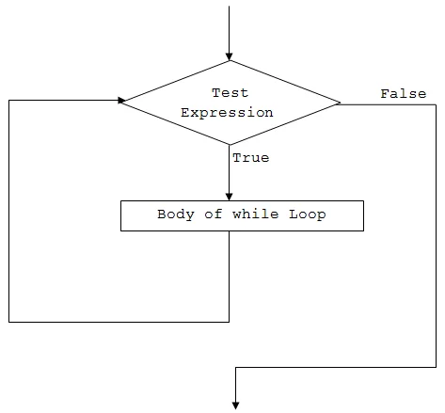
While Loop
Loops can execute a block of code as long as a specified condition is reached.
while (condition)
{
// code block to be executed
}
int i = 0;
while (i < 5)
{
Console.WriteLine(i);
i++;
}

Slide 20
int i = 0;
while (i < 2)
{
Console.WriteLine(i);
i++;
}
 | i Initial Value 0 | New Value (i++) | Condition i<2 | Result
1 iteration | 0 | 1 | 0<2 | true
2nd iteration | 1 | 2 | 1<2 | true
3rd iteraation | 2 |  | 2<2 | false

Slide 21
int i = 2;
while (i <=4 )
{
Console.WriteLine(i);
i++;
}
 | i Initial Value 2 | New Value (i++) | Condition i<2 | Result
1 iteration | 2 | 3 | 2<=4 | true
2nd iteration | 3 | 4 | 3<=4 | true
3rd iteration | 4 | 5 | 4<=4 | true
4th iteration | 5 |  | 5<=4 | false

Slide 22
While Loop
do
{
// code block to be executed
}
while (condition);
int i = 0;
do
{
Console.WriteLine(i);
i++;
}
while (i < 5);

Slide 23
For Loop
for (statement 1; statement 2; statement 3)
{
// code block to be executed
}
Statement 1 is executed (one time) before the execution of the code block.
Statement 2 defines the condition for executing the code block.
Statement 3 is executed (every time) after the code block has been executed.
for (initialization; condition; iterator)
{
// body of for loop
}
for (int i = 0; i < 5; i++)
{
Console.WriteLine(i);
}

Slide 24
for (int i = 0; i < 2; i++)
{
Console.WriteLine(i);
}
 | i Initial Value 0 | New Value (i++) | Condition i<2 | Result
1 iteration | 0 | 1 | 0<2 | true
2nd iteration | 1 | 2 | 1<2 | true
3rd iteration |  |  | 2<2 | false

Slide 25
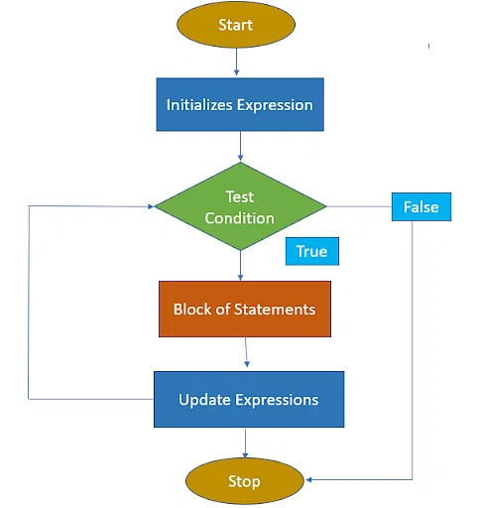
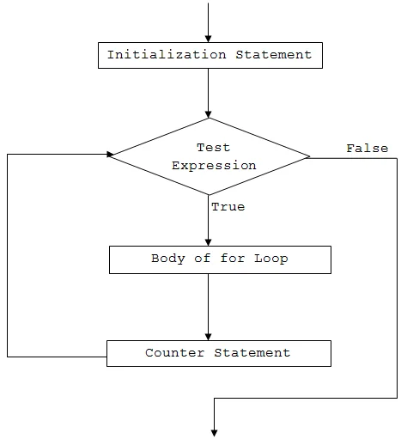

Slide 26
C# Break and Continue
for (int i = 0; i < 10; i++)
{
if (i == 4)
{
break;
}
Console.WriteLine(i);
}
The break statement can also be used to jump out of a loop.
for (int i = 0; i < 10; i++)
{
if (i == 4)
{
continue;
}
Console.WriteLine(i);
}

Slide 27
C# Arrays
Arrays are used to store multiple values in a single variable, instead of declaring separate variables for each value.
string[] cars;
string[] cars = {"Volvo", "BMW", "Ford", "Mazda"};
Access the Elements of an Array
Volvo | BMW | Ford | Mazda
0 | 1 | 2 | 3
string[] cars = {"Volvo", "BMW", "Ford", "Mazda"};
Console.WriteLine(cars[0]);
// Outputs Volvo

Slide 28
Change an Array Element
string[] cars = {"Volvo", "BMW", "Ford", "Mazda"};
cars[0] = "Opel";
Console.WriteLine(cars[0]);
// Now outputs Opel instead of Volvo
Array Length
string[] cars = {"Volvo", "BMW", "Ford", "Mazda"};
Console.WriteLine(cars.Length);
// Outputs 4

Slide 29
string[] cars = new string[4];
// Create an array of four elements and add values right away
string[] cars = new string[4] {"Volvo", "BMW", "Ford", "Mazda"};
// Create an array of four elements without specifying the size
string[] cars = new string[] {"Volvo", "BMW", "Ford", "Mazda"};
// Create an array of four elements, omitting the new keyword, and without specifying the size
string[] cars = {"Volvo", "BMW", "Ford", "Mazda"};
// Declare an array
string[] cars;
// Add values, using new
cars = new string[] {"Volvo", "BMW", "Ford"};
// Add values without using new (this will cause an error)
cars = {"Volvo", "BMW", "Ford"};

Slide 30
Loop Through an Array
string[] cars = {"Volvo", "BMW", "Ford", "Mazda"};
for (int i = 0; i < cars.Length; i++)
{
Console.WriteLine(cars[i]);
}
The foreach Loop
foreach (type variableName in arrayName)
{
// code block to be executed
}
string[] cars = {"Volvo", "BMW", "Ford", "Mazda"};
foreach (string i in cars)
{
Console.WriteLine(i);
}

Slide 31
Sort an Array
// Sort a string
string[] cars = {"Volvo", "BMW", "Ford", "Mazda"};
Array.Sort(cars);
foreach (string i in cars)
{
Console.WriteLine(i);
}
result
// Sort an int
int[] myNumbers = {5, 1, 8, 9};
Array.Sort(myNumbers);
foreach (int i in myNumbers)
{
Console.WriteLine(i);
}

Slide 32
HR Management
GetSalary(string emptype)
Tax Calculation

